Slide 1
Predicting customer behaviour using python
A British airlines project

Slide 2
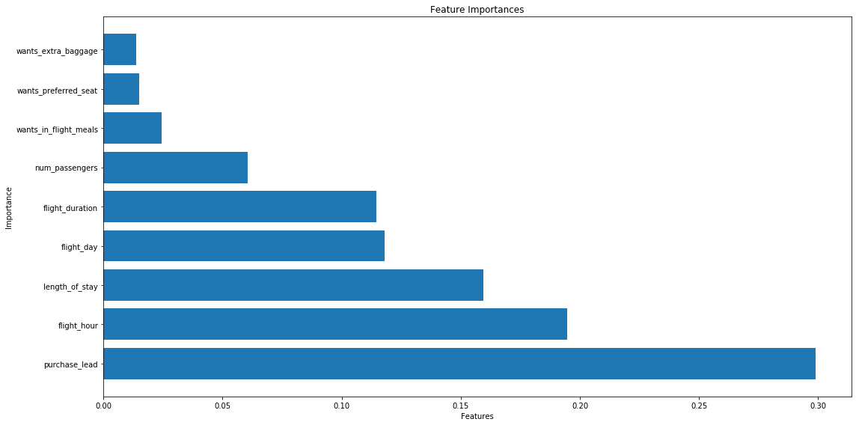
Visualization and recommendations
Based on the visual seen, the purchase lead is the most important feature to the model. Meaning that the time between booking and the actual flight determines whether the customer will purchase a ticket or not.

Slide 3
Model prediction

